Slide 1
Qualitative effects
Focal Regions as Attractors

Slide 2
Qualitative effects at both individual and dyad level
Model: P(k,i,s) = Bias_{k} + α*Sigmoid(s, β, γ)*I(I, k)*Focal(k)
+ δ*Sigmoid(FRAsim(i, k), ε, ζ)*Focal(k)
Behavior at the individual level
Behavior at the dyad level
k: region in grid; i: region visited on last round; s: score obtained on last round

Slide 3
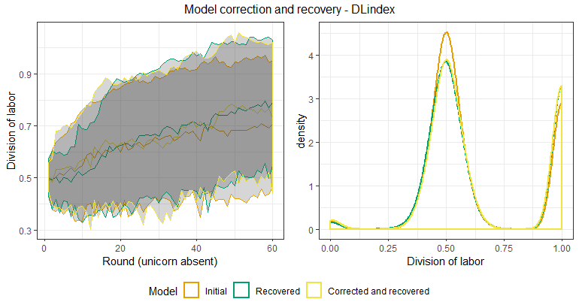
Sample variation (size =50)

Slide 4
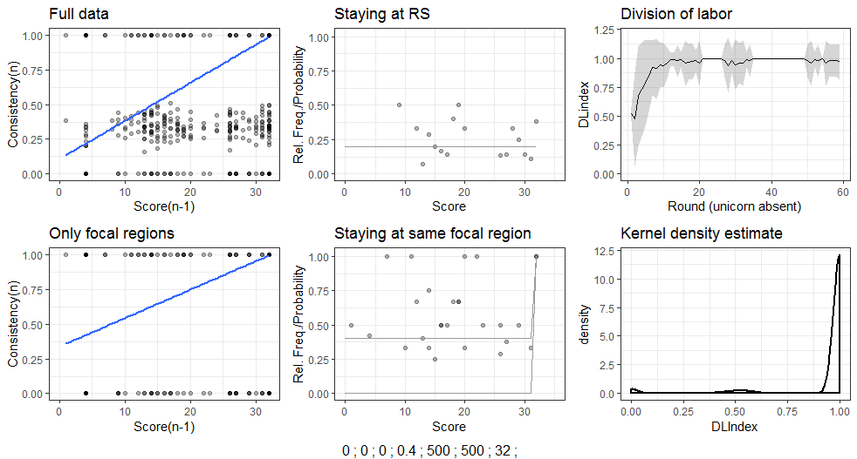
Qualitative effects (2 focal regions – high)

Slide 5
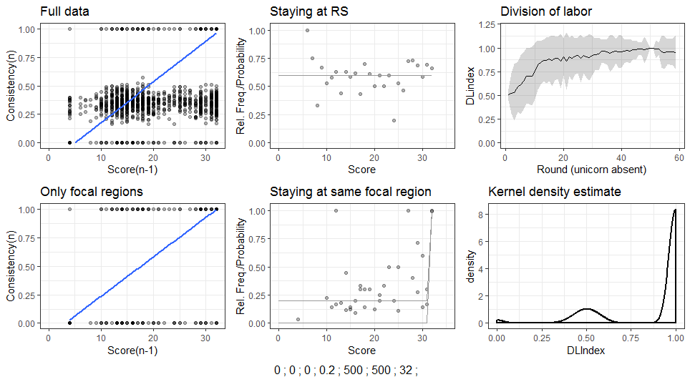
Qualitative effects (2 focal regions – medium)

Slide 6
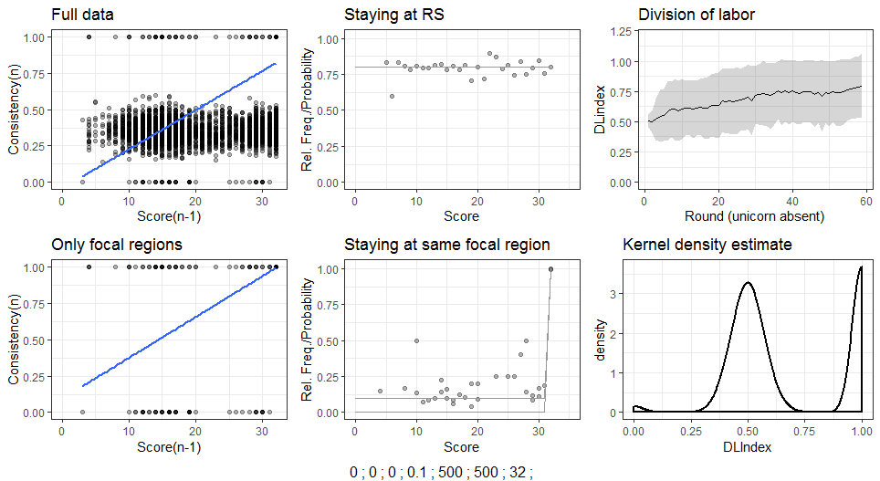
Qualitative effects (2 focal regions – low)

Slide 7
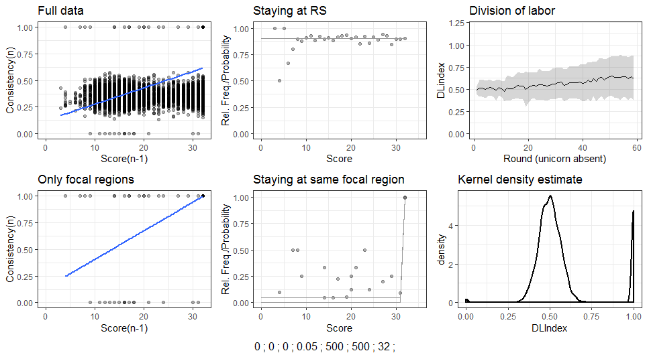
Qualitative effects (2 focal regions – too low)

Slide 8
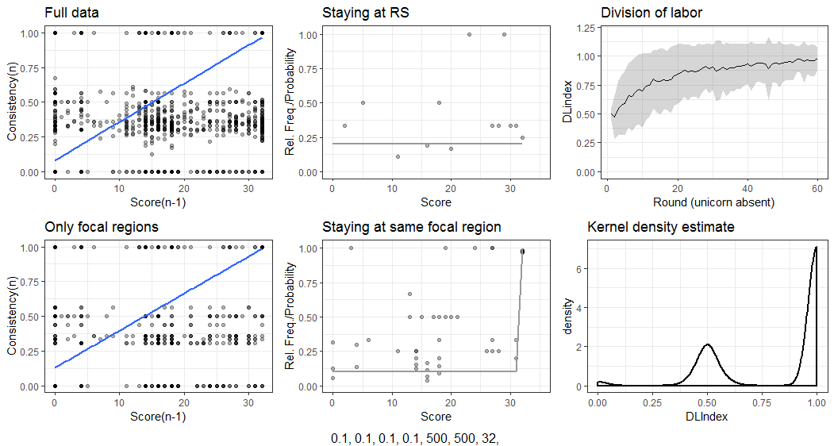
Qualitative effects (8 focal regions – high)

Slide 9
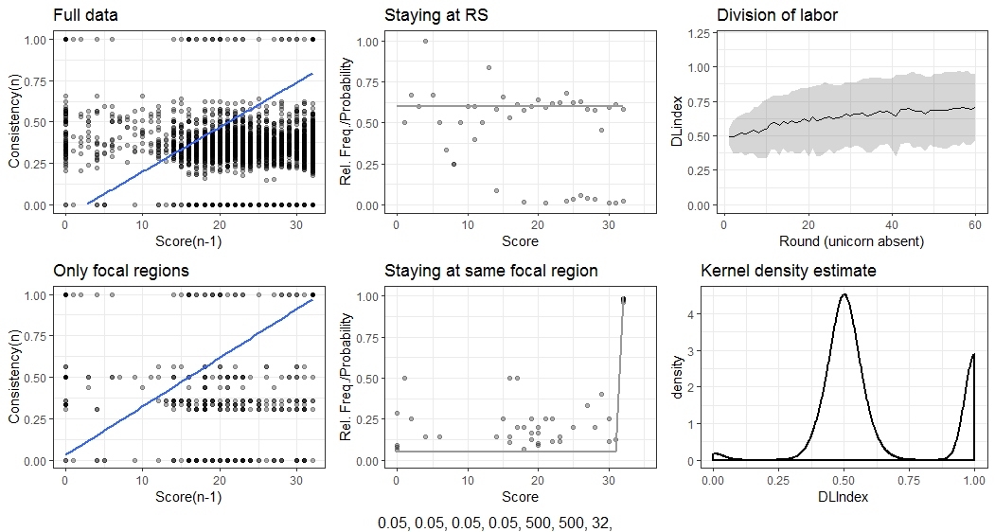
Qualitative effects (8 focal regions – medium)

Slide 10
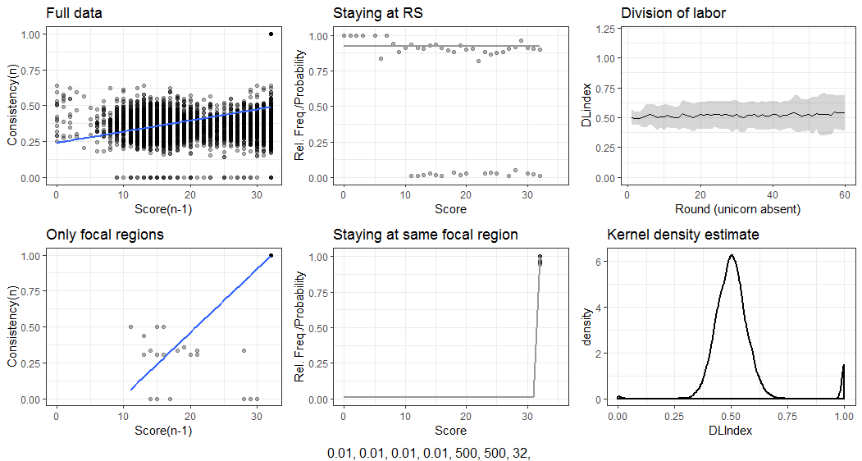
Qualitative effects (8 focal regions – low)

